Slide 1
Half a Decade in review
On accidental “hacking” and the hard problems
Notes:
Full disclosure: this is like /r showerthoughts

Slide 2
$whoami
@cubes_n_spheres
Pentesting, healthcare, etc.
Do I get a degree yet? Ya I doooo
The “human” angles of security:
politics/sociology/economics/biotech/cyberwarfare/etc.
Also I like other stuff

Slide 3
But $whoami Actually
And why all of this is a huge accident
Notes:
So like,

Slide 4
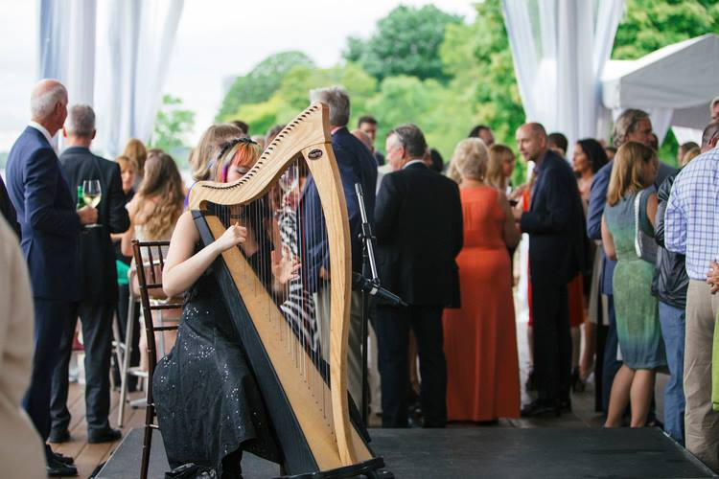

Slide 5
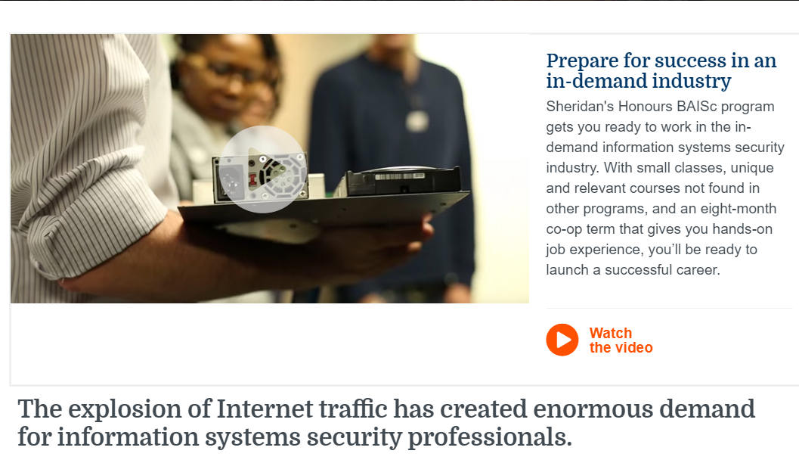

Slide 6
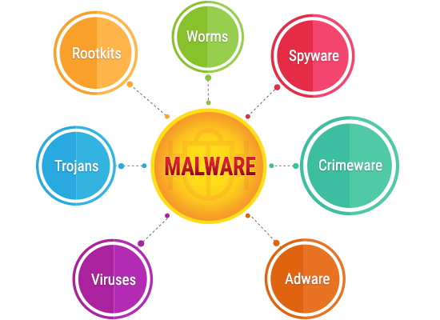

Slide 7


Slide 8
“Information security is just as much an art as it is a science”
Notes:
I like to believe I’ve made art of my young career at various points in time, especially here…

Slide 9

Recipe for surviving infosec
Blood
Sweat
Crying @ 4am
Notes:
Also lol can we take in how design ideas imagined these for us

Slide 10
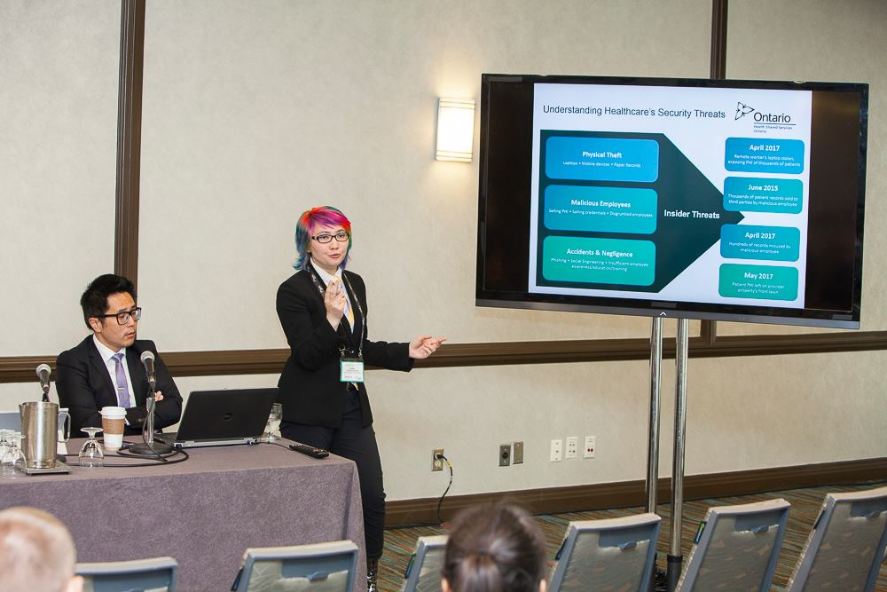
Notes:
If this doesn’t confirm that my life is an anime, I don’t know what does
And the reason I bring this up is partly because, according to recent media pieces I’ve been part of, this has motivational worth – especially when addressing the skills shortage (which I will talk about more in a few slides) but also because

Slide 11
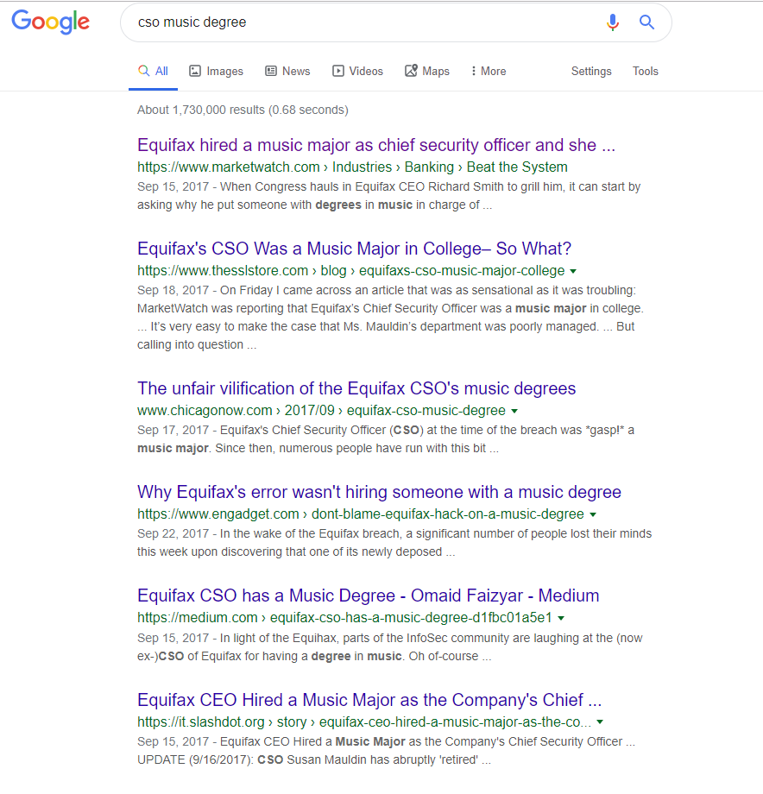
Notes:
My situation is obviously a little bit different since I didn’t get a prior degree, but this being said, it reflects a greater image of the trends of expectation in the industry. Where hacking was born out of a Libertarian ethos and a subculture that valued the artistic value of circumventing technological controls, we have a really interesting clash when the focus shifts to corporatization.
What this all boils down to is that money matters more than art… (and maybe rightfully so)
There’s an angle of the discussion where this suddenly becomes an attractive background story, but I’ll cover that later on in the presentation

Slide 12
The skills gap
And the all too common story about being the most qualified person in the room
Notes:
I want to talk about probably the biggest issue in the industry right now
This issue is inherently a very neutral one, but a lot of other contentious cultural issues are directly tied to it
I first experienced this in my first job…
And as I go through some of these topics, there will be more stories of this…

Slide 13


Being the Accidental Expert
VP of Privacy & Security
Senior Infosec Analyst
Me, a lowly
Infosec student
Notes:
End of that story: talk about rating your own VP applications
And having to tell the team that hiring a pentester for the role isn’t a good idea

Slide 14
The Skills Gap, Enumerated
2015
~ 1.5 million by 2019 (Symantec)
2016
~ 2 million by 2019 (ISACA)
2019
~ 3.5 million by 2021(ISC²)

Slide 15
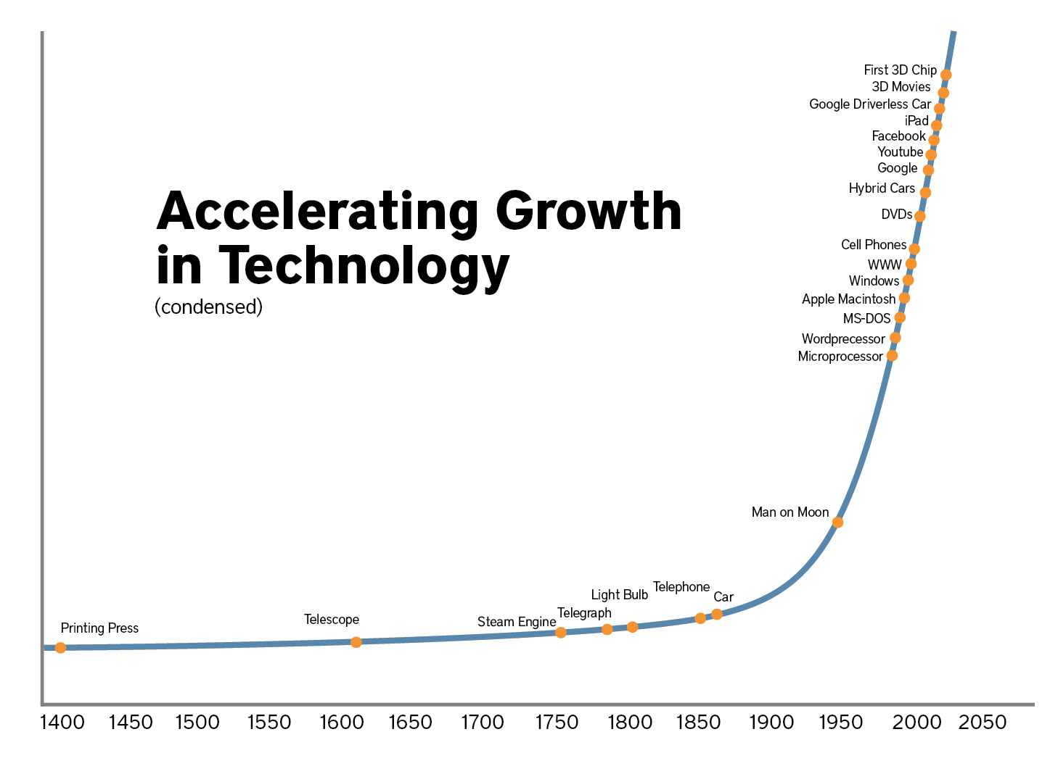
The thing about cyberspace
Notes:
If you’re thinking “why would that affect security”, well, the reason is because security is just a part of everything

Slide 16
The thing about cyberspace
Infosec ⊆ Digital Technology ⊆ Everything
(Not enough people to secure the lot of things)
(A lot of things)
Primary consequence: a lot of things are insecure

Slide 17
We live in a society
Notes:
The personnel s
i.e. it is by humans who already exist that INTERACT with new problems ➔ becomes overall a new iteration of old problems

Slide 18
other issues related to the skills gap
Burnout
Health
Diversity
Media
Education

Slide 19
On health, mental health, & Burnout
And why more coffee and booze aren’t the answer
Notes:
One of the first things I noticed, before anything else, was the strong booze/coffee culture
The biggest lie I was ever told…

Slide 20
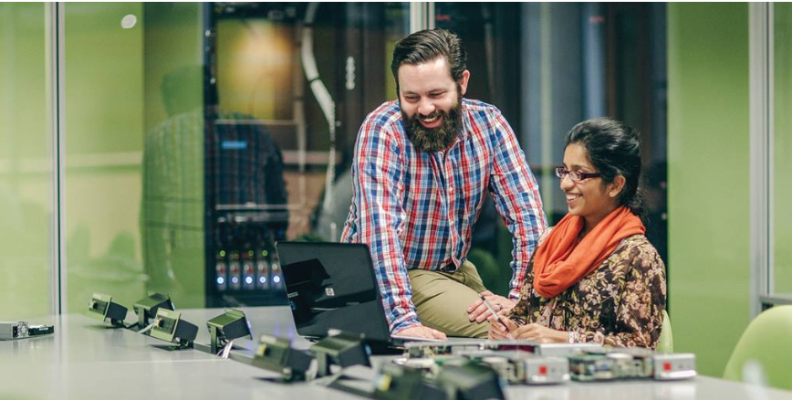
Notes:
The biggest lie I was ever told
With the personnel shortage, we have this issue where we want the industry to not seem like crap, so we have media like this

Slide 21

Notes:
But the infosec experience is actually a lot more like this
I thought maybe this was just a “me” problem but then, the other day, as I was scrolling through linkedin, I saw this…

Slide 22
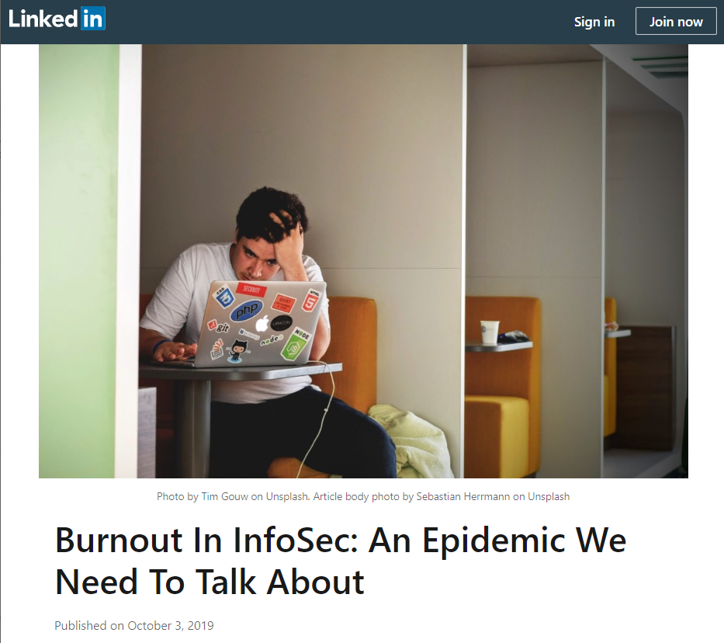

Slide 23
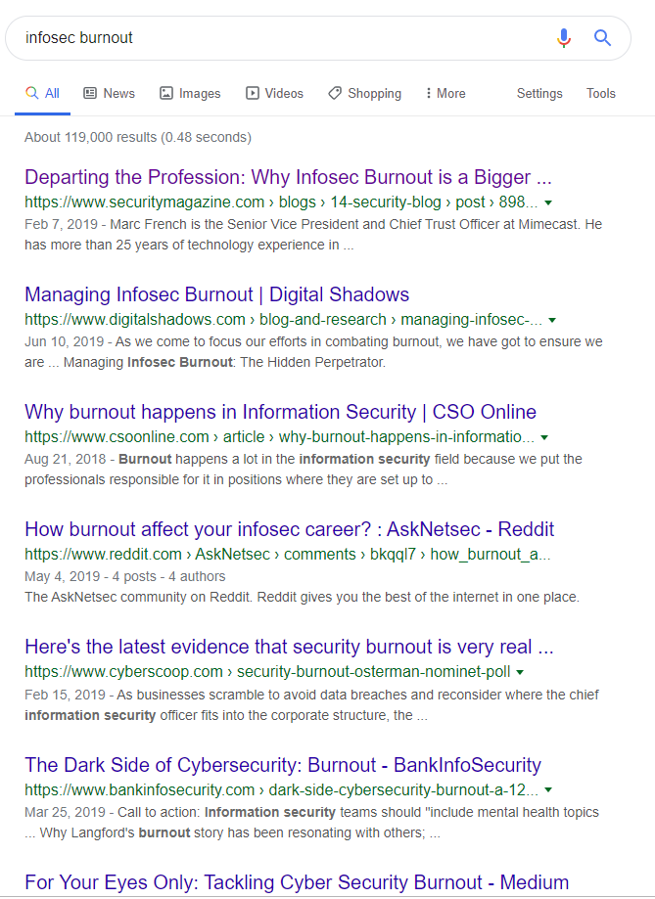

Notes:
Note the date on the twitter

Slide 24
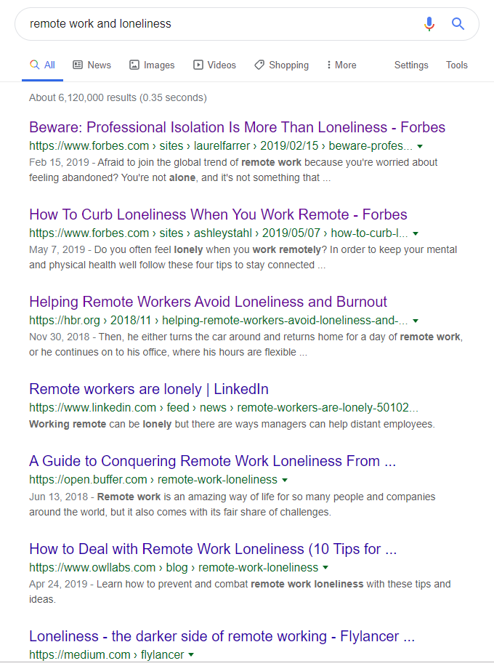
Some reasons for burnout
“low personal efficacy mixed with high cynicism”
Remote work == lonely?
Industry moves fast but initiatives move slow
Constant anxiety about getting pwned
No other silo likes security
Notes:
“low personal efficacy mixed with high cynicism”
i.e. we try to work too hard to make up for jobs that are just to check off a compliance thing etc.
Remote work == lonely?
Industry moves fast but initiatives move slow
Going back to the checkbox thing, we work on a lot of things that are eons behind how security has developed etc.
Constant anxiety about getting pwned
No other silo likes security

Slide 25

Also, the physical consequences
Sitting too much; posture
Using a mouse/phone constantly
Seeing a screen constantly
Bluelight
Notes:
…

Slide 26
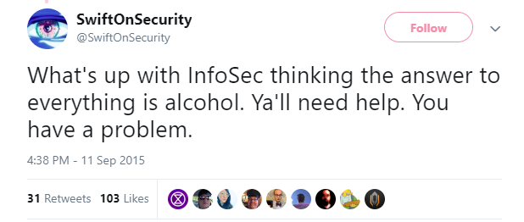
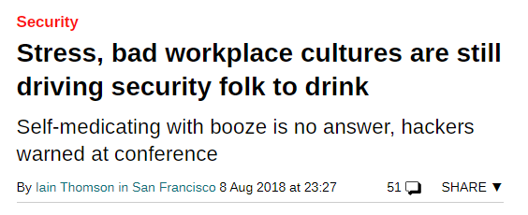
Also, the neurological consequences
Coping with InfoSec hell
Cortisol receptors
Stress
“Fight or flight”
Coincidentally, the same receptors affected by
Coffee
Alcohol
Notes:
…

Slide 27
The many faces of stress
Emotional symptoms
Being moody
Feeling overwhelmed
Can’t relax
Low self esteem
Depression
Self-isolation
Physical symptoms
Low energy
Headaches
Stomach problems
Muscle pains/aches/tenseness
Chest pain, heart problems
Insomnia
Lowered immune system
(…the list goes on)
Cognitive effects
Anxiety
Racing thoughts
Forgetfulness, disorganization
Difficulty focusing
Poor judgement
Cynicism
Notes:
So this looks like everything under the sun, but the reality is that it is – we’re so used to brushing off problems because we live and breathe security
This brings me to my next point about how coping is often the root of addiction, and what doesn’t help is our jobs could be considered addictive

Slide 28
Is infosec addictive?
And are we just playing the worst video game ever?
Notes:
I was going to try to make the connection between dopamine receptors and how the brain reacts to gamification
But then I realized that that’s a very involved topic and I didn’t have the time to make a real assertive hypothesis about it
That being said, I hilariously decided to just see what happens when I google “infosec addiction…”

Slide 29
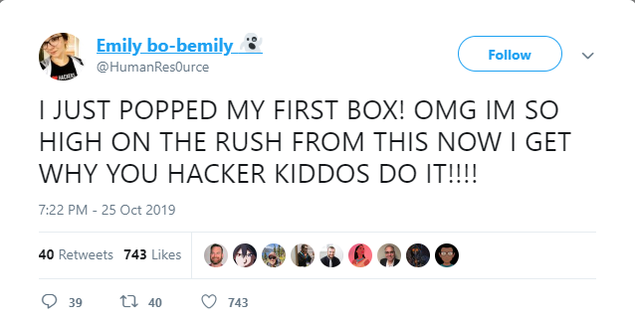

Slide 30
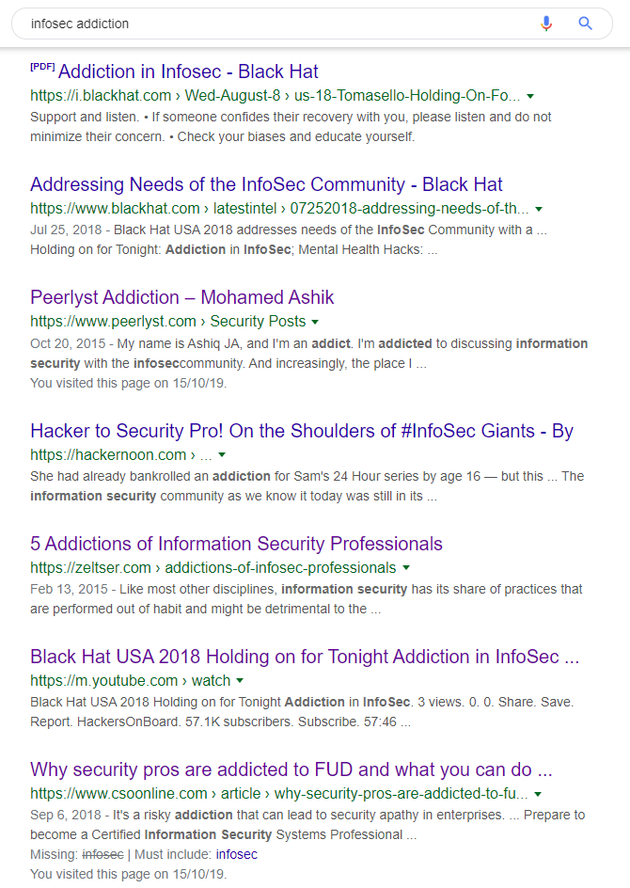
Notes:
The results that this one pulled up are not quite as uniform as the burnout search, but you get a good variety of serious responses – I’d say especially the BlackHat one

Slide 31
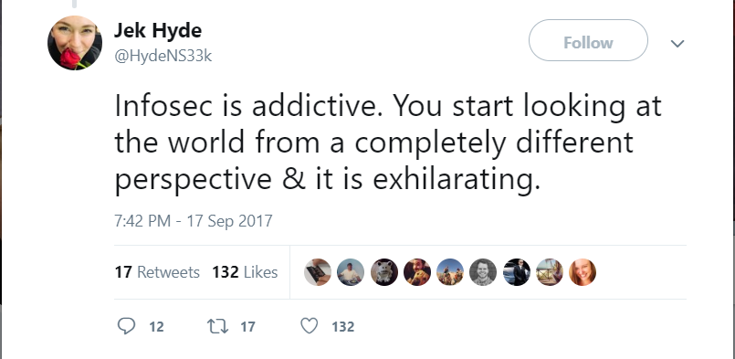

Slide 32
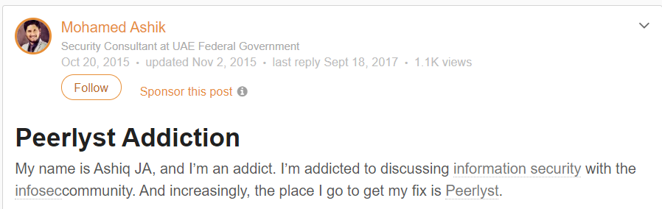

Slide 33
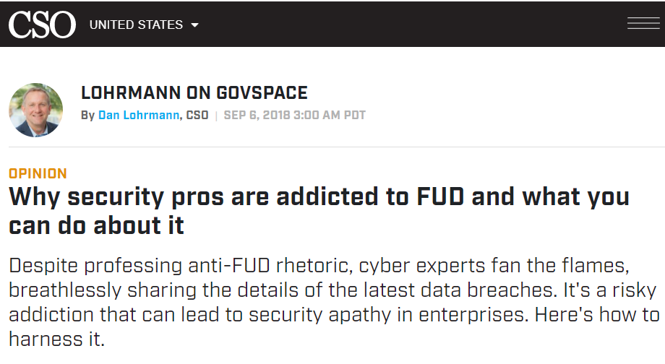
Notes:
Fear uncertainty doubt

Slide 34
Some theories for addiction
Disease Model (i.e. genetic disposition)
(re: potentially dangerous generalization of personality types drawn to computers…)
Reward Centre Hijack (i.e. instant gratification)
Self-medication Hypothesis (i.e. coping)
Notes:
On a lighter note, some of the google search responses can maybe be taken for their comic value, although you have to wonder just how deeply these problems run

Slide 35
Aspects of why
Gamification of processes and products used for the job
Feelings of duty – to job and also community
Need to cope – whether inside or outside of infosec
Social reinforcement
Notes:
Social reinforcement: especially with things like work culture that promotes 24/7 availability, using apps that abuse those same mechanisms for communication (e.g. slack), it all comes down to the nature of our job that is so heavily entwined with the Internet and being connected

Slide 36
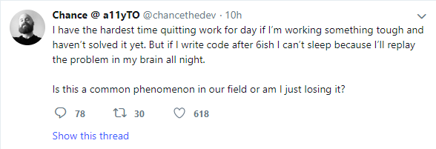
Symptoms of computer addiction (and by computer, I mean infosec)
Staying on much longer than intended
Thinking frequently about it
Failing to cut back
Hiding extent of use
Using as an escape
Missing out on time with other people/things/etc.

Slide 37
The bottom line
Work more ➔ make up for the Skills Gap
Burnout ➔ 0% productivity
Not a typical boardroom conversation
An unsustainable model
…Solutions?
Notes:
But solutions require analyzing what exactly keeps the skills gap happening, other than just the fact that tech expands fast and that the contemporary industry (i.e. in the context of it existing for commercial/private corp purposes)

Slide 38
The diversity problem
Why the 3.5 million-person gap could use a bit a lot of help
Notes:
The topic that everybody hates

Slide 39
Dimensions of diversity
The gender gap
2013-2017: 11% of women in global workforce (ISC², etc.)
2019: 24% of women in global workforce (ISC²)
Racial diversity
2016: 26% of minorities in global workforce (ISC²)
2017: 39% of minorities in large corporations (Information is Beautiful)
Notes:
Women is getting better but not enough
Racial is getting better but when we consider how many ethnicities there are in the world, it’s an extremely low proportion…

Slide 40
It’s not just about feelings
Diversity quotas & the “talent race”
Development of security controls & resulting biases
Again, the Skills Gap
Notes:
Quotas: explain the problem
Dev: the issue of who gets access to what information in the future is a reflection of the cultural biases we already have
(note: don’t explain too much b/c we have slides in a bit)

Slide 41
Diversity Quotas
Aggressively marketed opportunities for minorities
Perception of being hired “for the quota”
Being only asked to represent “the diversity problem”
Resulting contention
Balanced ratio ➔ no contention

Slide 42
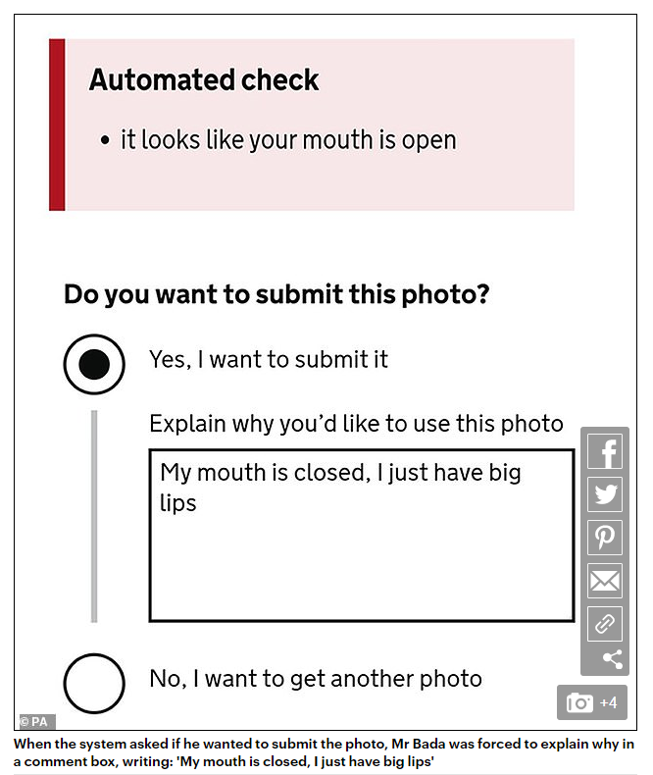
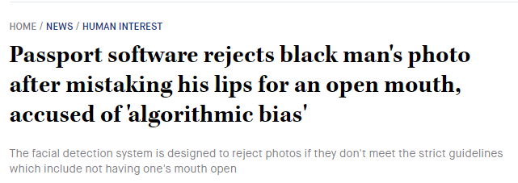
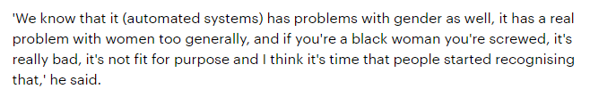
Biased Security Controls
Notes:
Note this might perhaps be viewed as a “data science”/general tech problem
However I would argue to you that either way, these are still components of security architecture in modern society;
Before security controls are implemented, they are architected on a conceptual level

Slide 43
The bigger picture
We need a lot of people
Minority groups don’t get as much social opportunity/encouragement
➔ Why don’t we just solve two problems at once?
Notes:
But of course, the answer is never that simple

Slide 44
Education & infosec
What happens when academia loses the educational arms race
Notes:
The way infosec expands, and tech in general, way outruns the models of education that we want to have
This is especially worse now that infosec has become a formal industry rather than a subcultural movement. We are starting to expect more credentials and reject simply having experience… (and moving away from the Equifax CISO situation)

Slide 45
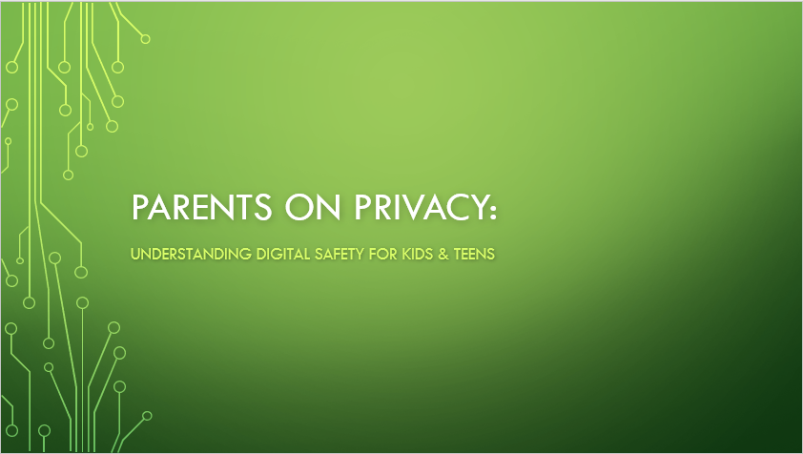
Story time
Notes:
Another story about being the accidental expert in the room…
What this all boils down to is that we don’t have an industry mature enough for these resources to be easily accessible to everyone, and so somehow a student that’s not a parent becomes the go-to person for this

Slide 46
The traditional dichotomy
Contemporary InfoSec
Defensive and offensive
Pro-institution
Admires creativity
But lacks history
Hacking
“Offensive” mindset
Subcultural; anti-institution
Artful
After coining “hacking”, but before contemporary InfoSec
Academia
Actual “OG” hacking
“Defensive” mindset
Pro-institution
Not seen as artful/edgy per se
Conclusion: Education is perpetually playing “catch up” to try to meet the Skills Gap
(also educational institutions are self-interested businesses)
Notes:
Hacking and academia don’t go together b/c hacking was a subculture
(although ironically the conception of the word “hacking” has an academic background”
It’s important to note that infosec actually has an old history dating back to ancient civs., but for the sake of argument we’ll say we’re talking about infosec that is in the context of digital systems and for more than just military/gov/state purposes – for priv corps, commercial uses, everyday life etc.
The thing about contemporary infosec is it’s fused either of the two, which is why we start seeing acceptance of things like going to school for infosec/hacking
In any case, the point I’m getting at:
Infosec as an educational curriculum in itself is not that old
Knowing a system well was perhaps an aspect of digital systems engineering in academia
However, the hacking perspective of “breaking” something was not as much
Contemporary infosec both lacks the streamlined curriculum of other industries that were rooted in academia, because the idea of circumventing controls really grew in a movement that existed outside of traditional institutions
The issue we have now is that academia is not equipped to “catch up” with the skills gap; even though new initiatives are popping up (e.g. new short programs, bootcamps, etc.), it doesn’t match the rapidly expanding gap
From the “hacking” perspective this isn’t a “problem” per se, but I’d argue that infosec and the skills gap make it a problem:
it’s more efficient to streamline learning to get more people in; people want a job, not necessarily a high-risk of self-learning
The reality is more corps/jobs want actual credentials now
The argument of creating rigid industry vocab/best practices etc. is better streamlined through well planned courses; it’s the difference between a dev going to “boot camp” vs. an engineer knowing how to architect a system to be more efficient (e.g. with knowledge of data algos, policy architecture, etc.) Not to mention that these programs are not always created with the best interests in mind. Let’s not forget that cybersecurity is the newest hot topic with a guaranteed hire rate, and institutions want in. If anyone in the room went through my class we know this all too well…

Slide 47
Expected demographic of professors
Notes:
When you shell out tens of thousands of dollars, you hope this would be the case…

Slide 48
Actual demographics of professors
Notes:
And why does this happen?

Slide 49
$$$ and teaching incentives
The barriers of good education when it’s versus a corporation that wants to make money:
Credentials required for teaching (1 above rule)
Credential quotas
Credentials =/= good at teaching
It pays to not teach
Curriculum changes are hard
Notes:
This is not to say that people don’t want to help
There are two paths: not teaching and making bank or teaching and giving that up
The way they place instructors lead to that last problem I outlined about having the wrong profs in the wrong sub-subjects (i.e. because they don’t want to pay full time placements)
Credential quotas: i.e. the phd ratio etc.

Slide 50
The bottom line
Cynicism, lack of enthusiasm around infosec education
Those who could provide quality education ➔ not even allowed to teach
More difficult to streamline the learning of industry standards + expected skills
➔ Doesn’t help the Skills Gap, where we arguably need it most
Notes:
But solutions require analyzing what exactly keeps the skills gap happening, other than just the fact that tech expands fast and that the contemporary industry (i.e. in the context of it existing for commercial/private corp purposes)
…
So what other component affects how we incentivize people to come into the industry?

Slide 51
The media
Why it’s hard to deviate from the “loner hoodied hacker”, and other image problems

Slide 52
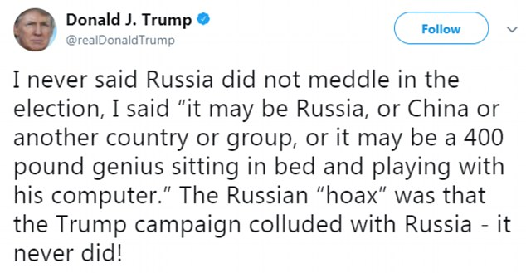


Slide 53
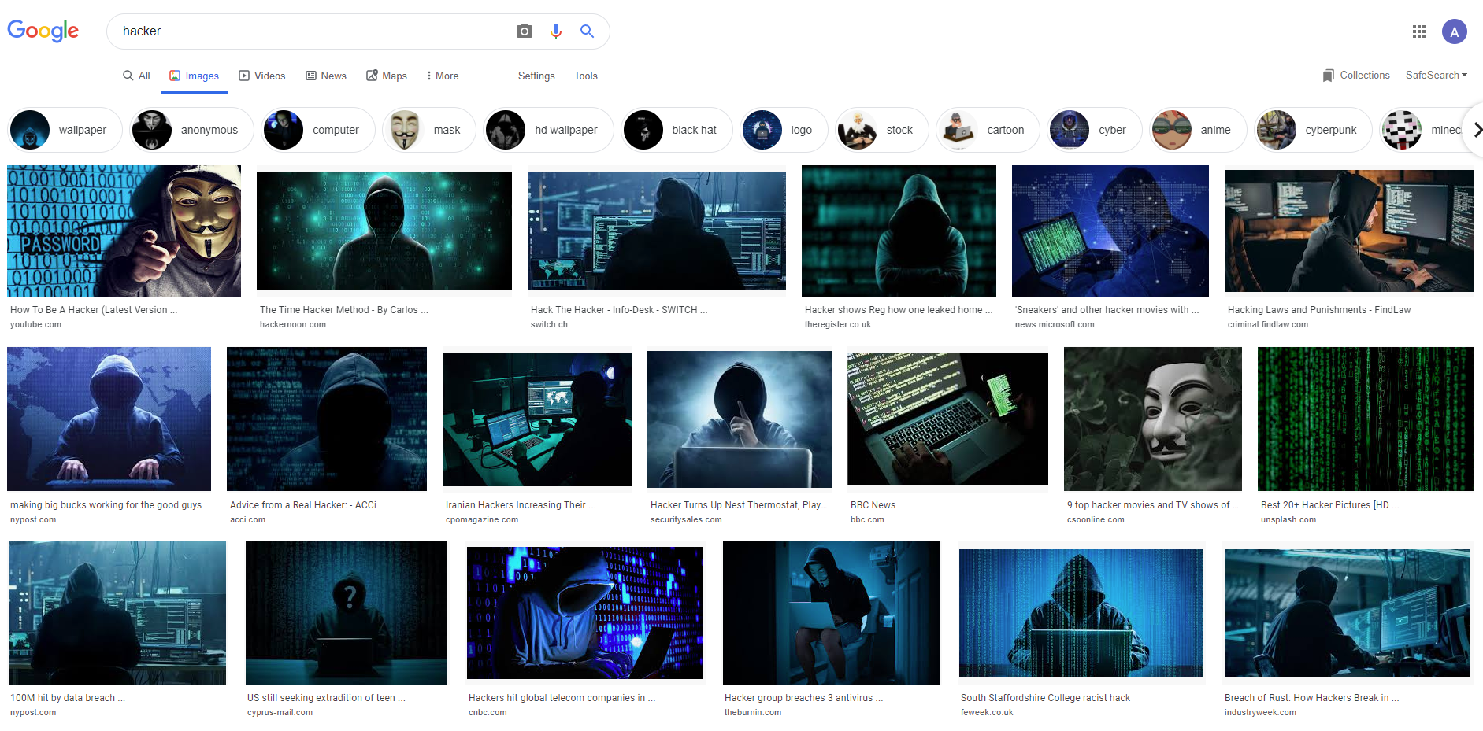

Slide 54
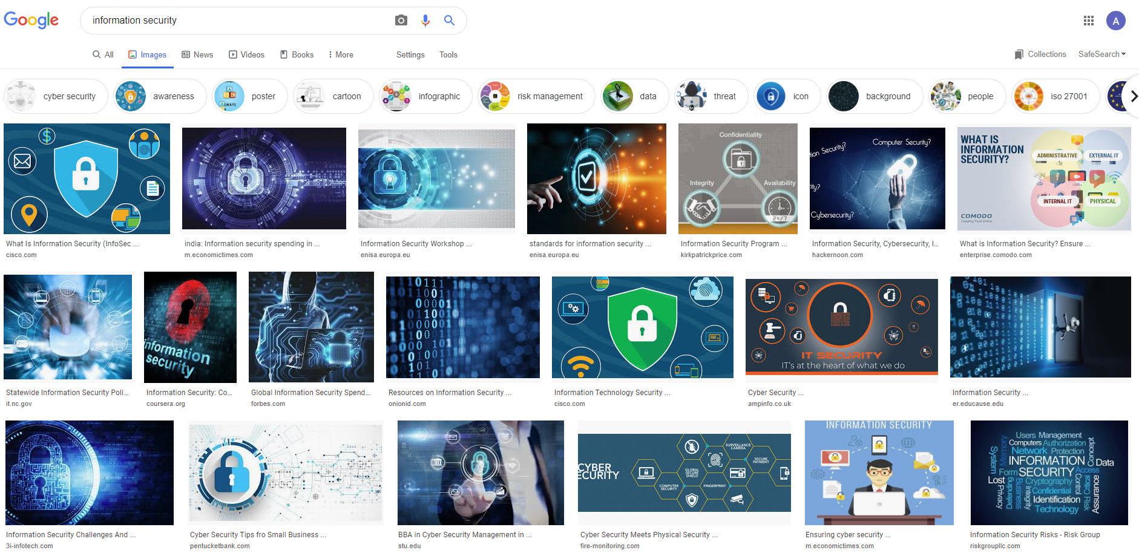

Slide 55
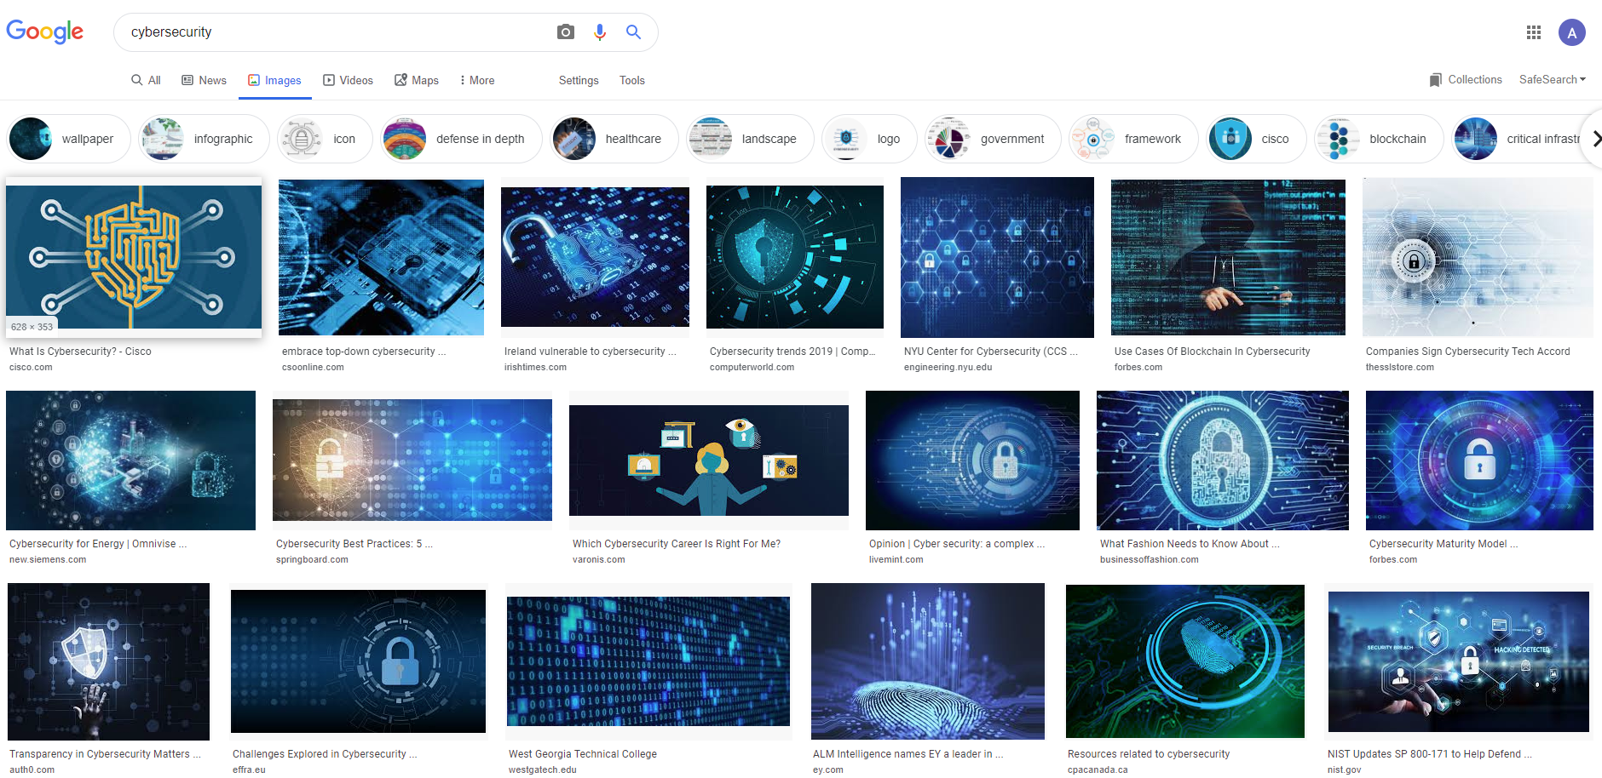

Slide 56
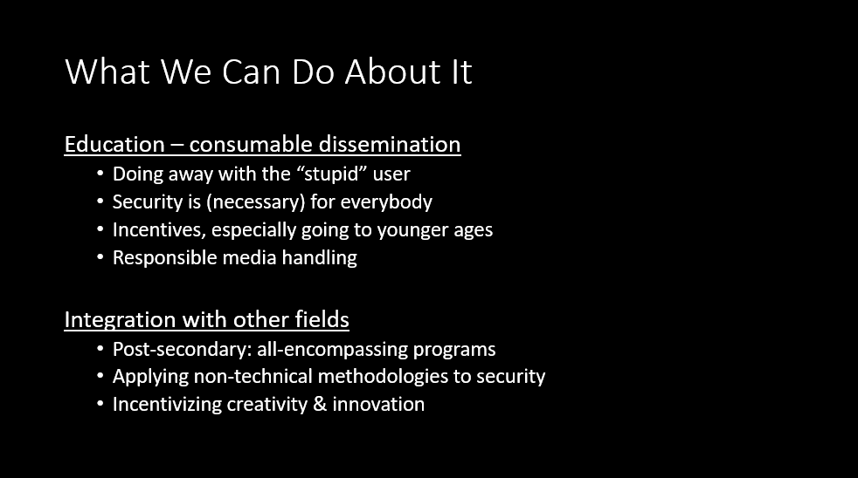

Slide 57
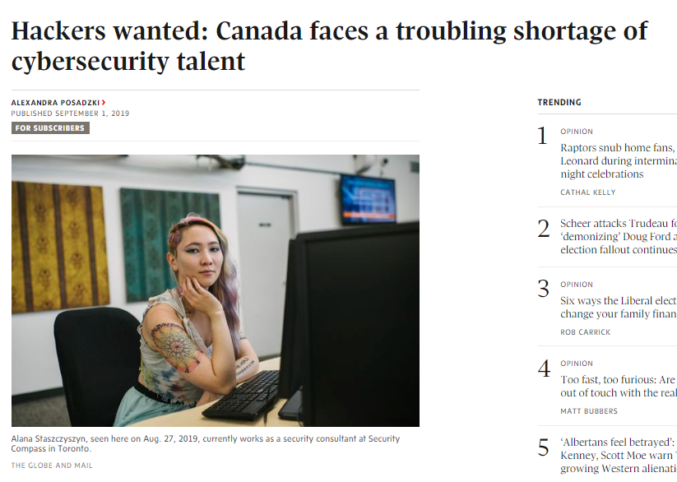

Slide 58
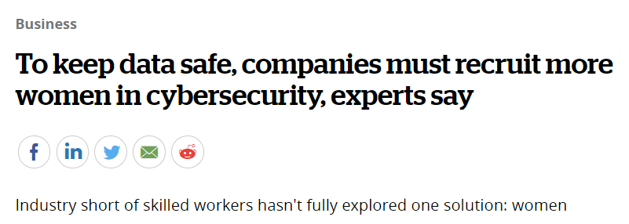
Her male classmates tended to be the coding- and robotics-club types, and since they didn't recognize her as one of their own, she had to "work a bit harder to prove that I could do things and I knew stuff."
Notes:
Maybe it was totally my fault for not being careful about how I worded things, even though the other article paraphrased me well – but come on, I said like 30 minutes of other intelligible things, was that really the best quote they could’ve used?
The article started with a lot of explanations of the issue, with very little end-details about where women can find resources

Slide 59
Media control is hard
Overlooking important rhetoric to build the narrative
Being a small part of some bigger (different) narrative
Every detail can be taken out of context
Journalists are guessing; narrative isn’t necessarily
Productive
One you believe in
Accurate
Bottom Line: Would women want to join the industry after reading this?

Slide 60
What do we do?
We got 99 problems and the skills gap is basically all of them

Slide 61
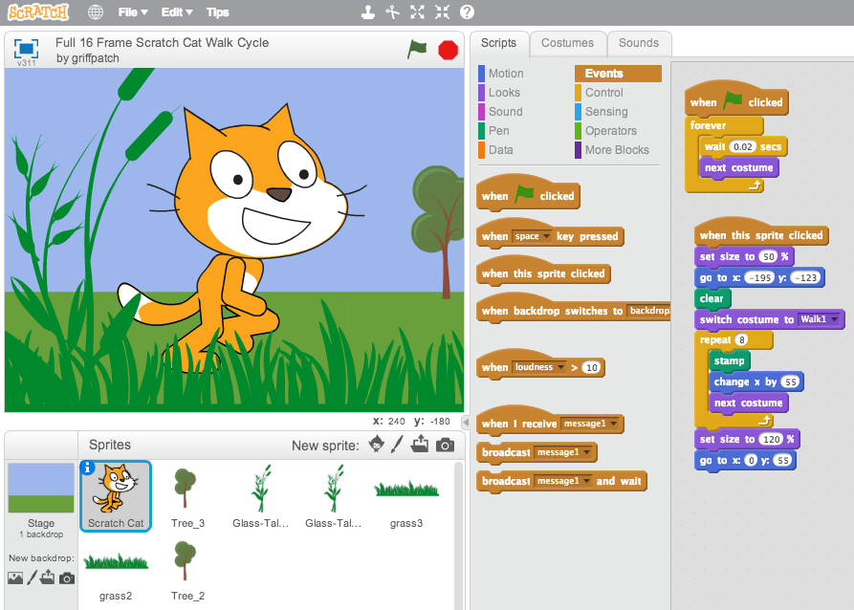
Gamification
“Addict” ourselves to:
Learning (e.g. CTFs!)
Healthier habits
Reinforcing work/life balance*
(I don’t know how but everything is gamified, there has to be a way)
Notes:
Last point: productivity apps? As an example

Slide 62
Community awareness
Create awareness about:
The Skills Gap as an overarching problem
Role of the diversity gap
Why education isn’t helping the problem
Why the media isn’t helping the problem
Industry stresses and coping patterns; support systems

Slide 63
Awareness about support systems
Recognizing the signs
Knowing your rights as a worker
Ending stigma

Slide 64
Community initiatives
Community is what makes our industry strong
Support systems in the community
Continue providing alternative learning
Workshops/talks/certifications/CTFs/open source/etc.
Encouraging intersections with other non-technical areas of infosec
Especially: culture & media surrounding infosec
Outreach to diverse & young talent pools
Notes:
For the last two points, maybe weave in the Scratch Jr. story

Slide 65
The end
@cubes_n_spheres

